Slide 1
Introduction to Biophysics II:
Quantum Biology
Phenomena:
Photosynthesis
Vision
Avian compass
Sense of smell
Methods:
Optical spectroscopy
Modeling complex systems
Theory (Quantum mechanics):
Absorption/emission of light
Electron transfer/tunneling
Molecular vibrations
Coupled electronic states (excitons)
Forster and Dexter energy transfer
Redfield theory of energy transfer

Slide 2
Introduction to Biophysics II:
Quantum Biology
Lecture 01
Introduction
Photosynthesis
Electron wavefunctions
Syllabus
What is life?
Photosynthesis: an overview
Electron wavefunctions (hydrogen atom)

Slide 3
About the course
Meeting Time and Place:
TTh 4:30-5:45
PHYS 338
Instructor:
Prof. Sergei Savikhin
Office: PHYS 64
email: sergei@purdue.edu
Office hours: by request
Brightspace: https://purdue.brightspace.com/d2l/le/content/1499248/Home
Course credits: 3

Slide 4
About the course
Recommended Material Related to the Course:
https://web.ics.purdue.edu/~sergei/classes/quantum_biology
Recommended Text(s):
Modern Optical Spectroscopy. With exercises and examples from biophysics and biochemistry. W.W. Parson. 2nd edition, Springer 2015
Quantum Effects in Biology. Eds. M. Mohseni, Y. Omar, G.S. Engel, M.B. Plenio. Cambridge 2014
Suggested additional readings:
Philip Nelson, Biological Physics, 2008: chapters on cell and amino acid structure
Glaser “Biophysics”
Schrödinger “What is life”
Meyer B. Jackson, Molecular and Cellular Biophysics, 2006.
Introductory biochemistry text, for example, Jeremy M. Berg, John L. Tymoczko, and Lubert Stryer “Biochemistry”.
Selected chapters from Eric R. Kandel and James H. Schwartz, Principles of Neural Science, 2000

Slide 5
About the course
Grading:
Homeworks/ projects 50%
Oral presentation of a paper from a research journal. 50%
(Select biophysics-oriented paper from recent publications)

Slide 6
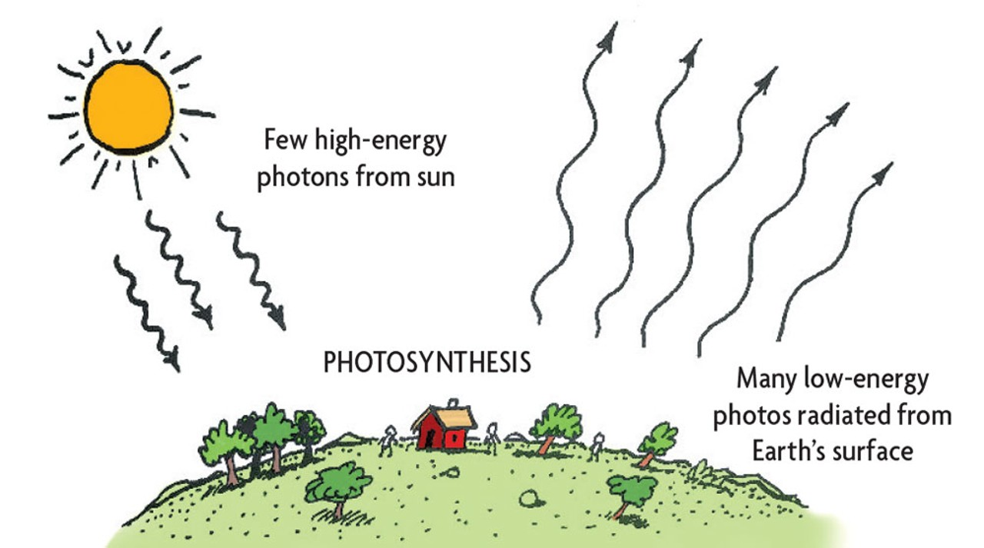
What is life?
https://www.northcoastjournal.com/life-outdoors/fighting-entropy-11177235
Notes:
Discuss: how can we define life?
What about entropy?
Where does the energy come from?
What about energy conservation?
Analogy – how does a heat engine work?
Is energy “used”?
Entropy – increasing → can extract part of energy in “larger” chunks, increasing “chunk” size decreases entropy
Temperature difference!
Life: is there a “temperature” difference?
What is the temperature of sunlight? (EM field)
What is the average energy of a photon? ~2eV
What is the average energy of a phonon? ~25 meV
Looks like a heat engine ?
Photosynthesis!
Life is a middleman – takes in photons at 2 eV and converts to heat 25 meV
6000K → 300K – can lower entropy in live organism, coupled reactions

Slide 7
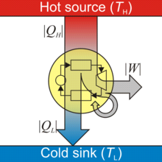
What is life?... Heat engine…

Slide 8
Life: lowering entropy
Photon at 6000 K: ~ 2 eV
Photon at 300 K: ~ 0.025 eV
Net entropy increases – photosynthesis is a middleman, decreases entropy locally
ADP → ATP: 0.31 eV
Synthesis of a typical protein (200 amino acids): ~250 eV
https://www.northcoastjournal.com/life-outdoors/fighting-entropy-11177235

Slide 9
Lectures 01-05
Photosynthesis:
Overview
Physical principles governing photosynthesis
Electronic properties of complex molecules
Absorption of light
Energy transfer
Electron transfer
Reading:
WW Parson. Modern Optical Spectroscopy.
Chapter 2; Chapter 1.
2. DJ Griffits. Introduction to Quantum Mechanics.
Chapter 9, Time-dependent Perturbation Theory

Slide 10

Photosynthesis
Photo – light
Synthesis - building
light
CO₂ + H₂O (CH₂O) + O₂
100 TW (10¹⁴ W = 100,000,000,000 kW)

Slide 11

Top 10: Life's greatest inventions
1. Multicellularity
2. The eye
3. The brain
4. Language
5. Photosynthesis
6. Sex
7. Death
8. Parasitism
9. Superorganism
10. Symbiosis
04 September 2006
NewScientist.com
Notes:
\

Slide 12
Photosynthesis: energy
Photosynthesis: ~100 TW
Human society in 2012 : ~17 TW
in 2023: ~ 18 TW (electrical ~3.2 TW)
Sunlight total : 120,000 TW (fall on Earth)
usable : 800 TW (can harvest)
Note: most of the new energy comes from renewables
Notes:
\

Slide 13
Photosynthesis
Simplified block-diagram:
Simplified chemical reaction:
Biosynthesis
light
CO₂ + H₂O (CH₂O) + O₂
hν
energy
Reaction
center (RC)
current
Chemical
battery
Antenna
Antenna captures light and passes its energy to RC
Reaction center generates electrical current
The electrical current drives chemical reactions creating molecules that store energy in their chemical bonds
Notes:
\

Slide 14
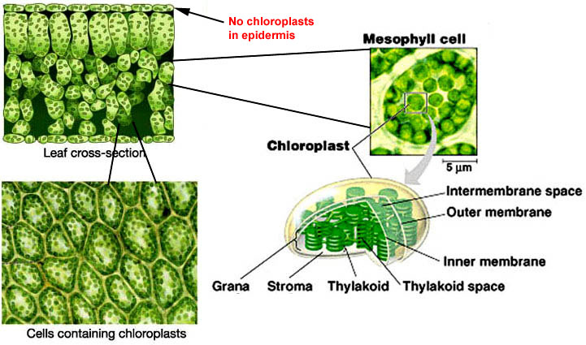
Photosynthetic apparatus of plants
Photosynthetic powerplant is located in thylakoid membranes
Notes:
\

Slide 15
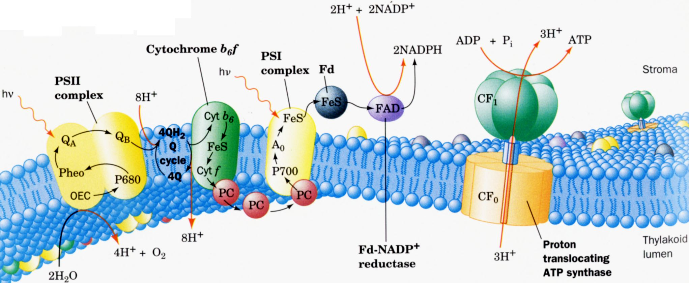
Photosynthetic apparatus: PS II
Photosystem II (PS II) complex uses energy of light to split water and generate electron and proton current.
Oxygen molecules are byproduct of this processes
The PS II is extremely strong oxidant - it can oxidize water!
Notes:
\

Slide 16
Photosynthetic apparatus: cytochrome b₆f
Cytochrome b₆f complex transfers electrons (current) from PS II to photosystem I (PS I) complex.
In addition, the fraction of this electron current is used to transports protons across the thylakoid membrane.
Plastoquinones (Q, QH₂) and plastocyanins (PC) serve as intermediate electron carriers
Notes:
\

Slide 17
Photosynthetic apparatus: PS I
Photosystem I gets electrons from PS II via cytochrome b₆f and uses light to boost the energy of these electrons and transfer them to mobile ferredoxin (Fd) complex
Notes:
\

Slide 18
Photosynthetic apparatus: FAD
Ferredoxin (Fd) uses the energy of the electron to reduce NADP⁺ molecule to NADPH and store the energy in chemical bond of NADPH. This reaction is mediated by ferredoxin-NADP⁺ reductase (FAD)
Notes:
\

Slide 19
Photosynthetic apparatus: proton pumps
PS II and cytochrome b₆f also pump protons creating elecrtochemical potential across the membrane (like charging a capacitor). That creates strong electric field across the membrane.
Notes:
\

Slide 20
Photosynthetic apparatus: ATP synthase
This strong electric field drives protons through a molecular size ‘turbine’ motor called ATP synthase. The axle of that molecule spins and mechanical force drives chemical reaction transforming ADP molecule to ATP - the energy is stored in extra chemical bond
Notes:
\

Slide 21
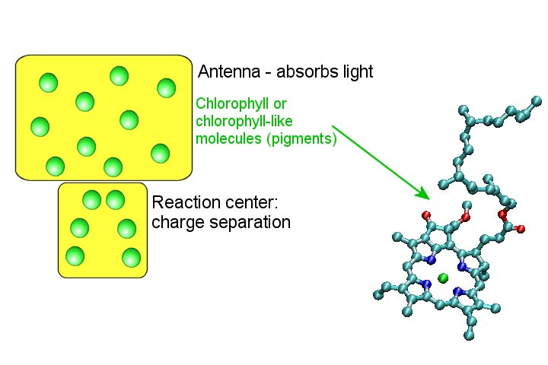
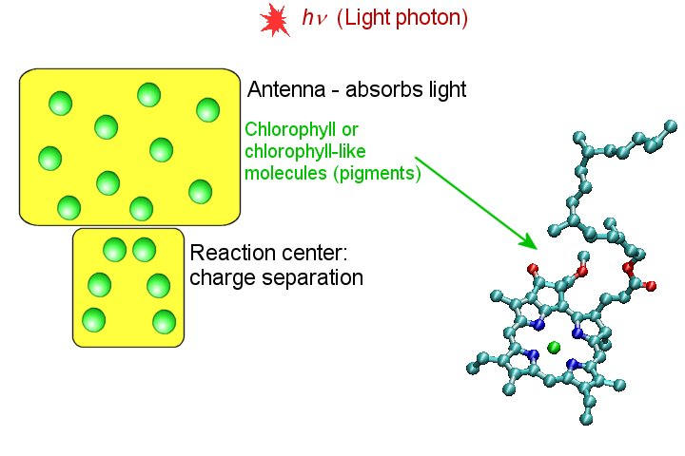
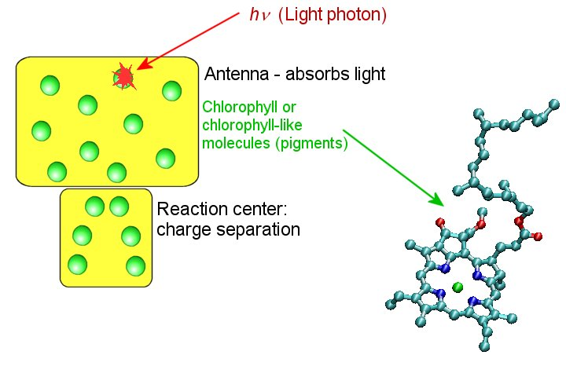

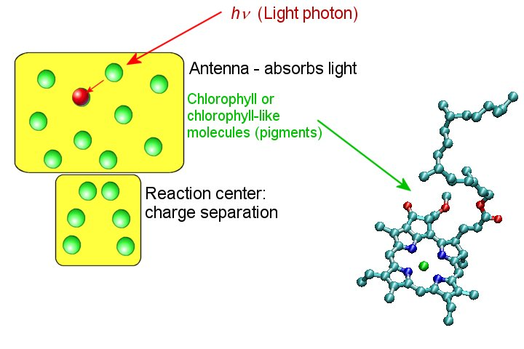
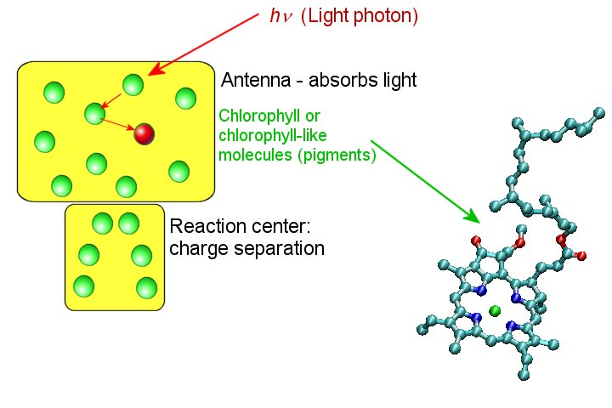
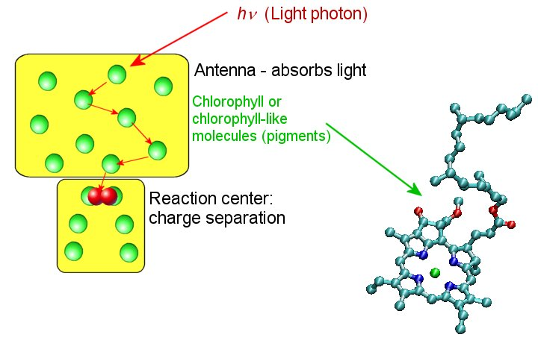
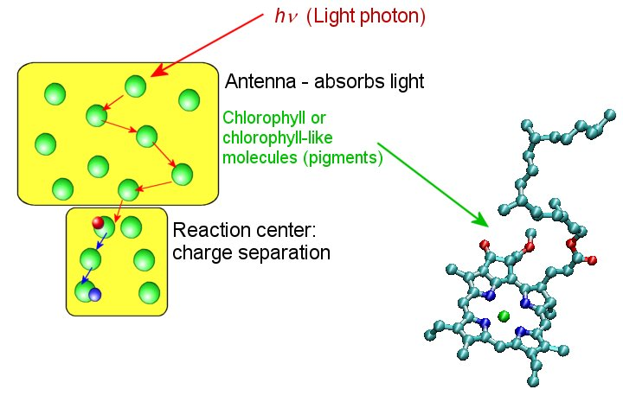
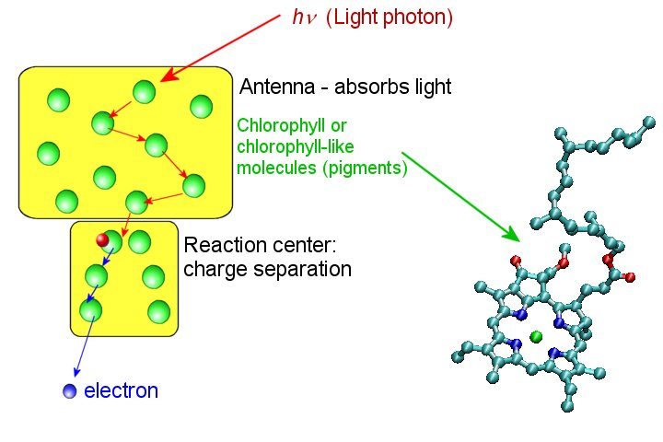
Antenna and reaction center
Large variety of different photosynthetic systems (plants, bacteria, algae) share two common elements: light-harvesting antenna and reaction center (RC).
Notes:
21

Slide 22
Questions
How is light energy stored by a molecule?
How is that energy transferred toward the reaction center?
How is the energy used to initiate charge separation?
How can electron be transferred through a protein?

Slide 23
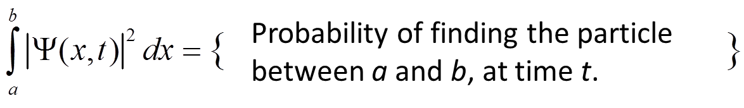
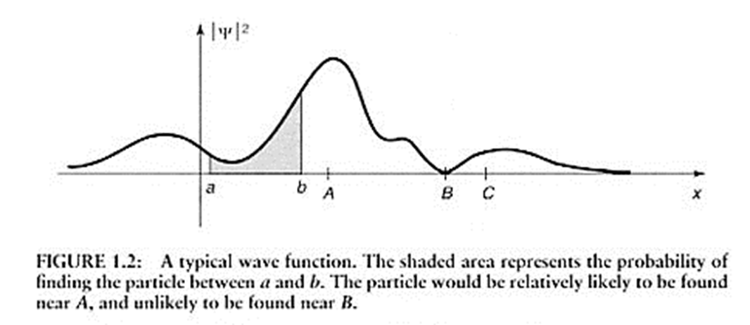
Wave function
Particles (electrons) are represented by a wave function:

Slide 24
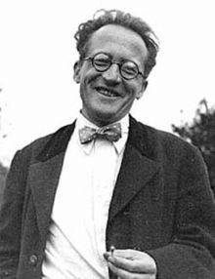
Schrödinger Equation
Evolution of a particle is described by Schrödinger Equation (1926)
(it is a wave equation):
(in one dimension)
- Wave function
m – mass of the particle
V(x,t) – potential energy
Erwin Rudolf Josef Alexander Schrödinger
1987 - 1961

Slide 25
Operators
Physical quantities are represented by operators:
Expectation value:
Examples:
Operators:
- position
- momentum
energy

Slide 26
Hermitian operators
- Measurable physical quantities must be represented by Hermitian operators! – since measurable quantities are real numbers:
Or:
Notes:
Hermi’shn

Slide 27
Time-independent SE
- Time-independent Schrödinger Equation:
when H depends on coordinates only and not on time:
Solutions to time-independent SE are stationary states with defined energy E
Any particle state can be represented as a superposition of stationary states, each oscillating at frequency defined by energy E.
Solutions are orthogonal and normalizable:

Slide 28



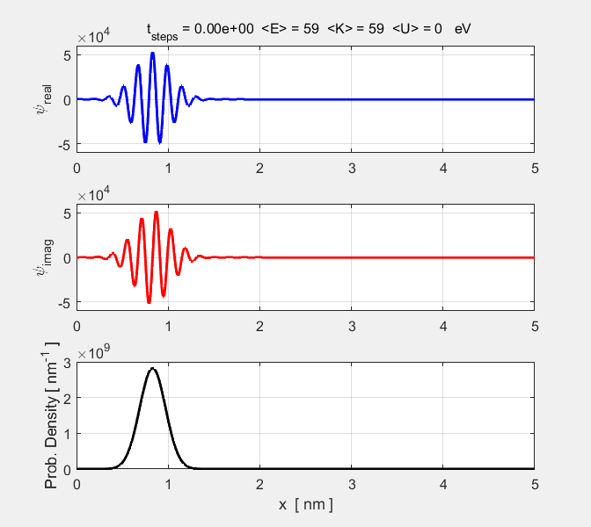
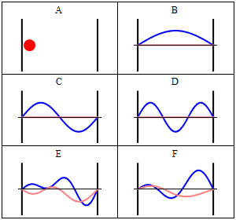
Free vs confined particle
Particle in a box:
Confined wave, discrete E
Quantum mechanics:
- Free particle:
Wave, Continuous spectrum of E
Superposition of multiple ψ
Classical
Ψ₁
Re(Ψ)
Im(Ψ)
Ψ₂
Ψ₃
Stationary
Superposition of
Ψ₁, Ψ₂, Ψ₃ and Ψ₄,

Slide 29
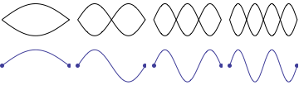
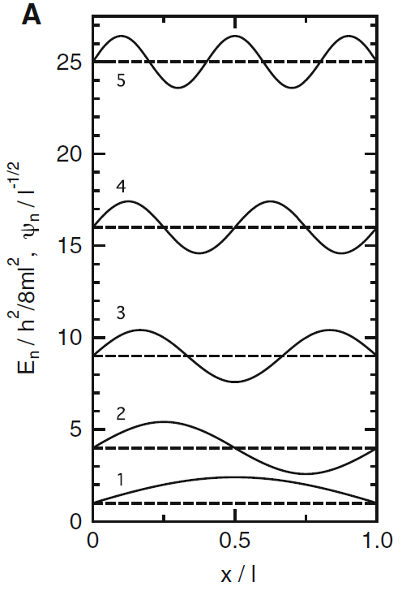
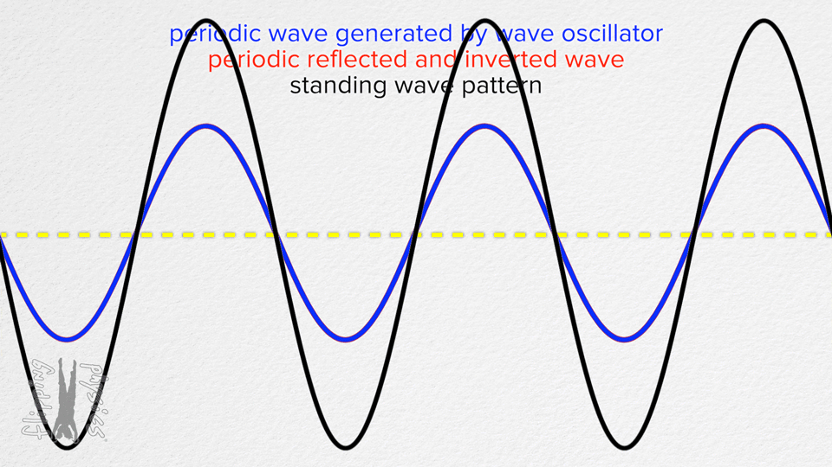
Free vs confined particle
Particle in a box:
Confined wave, discrete E
Standing waves:

Slide 30
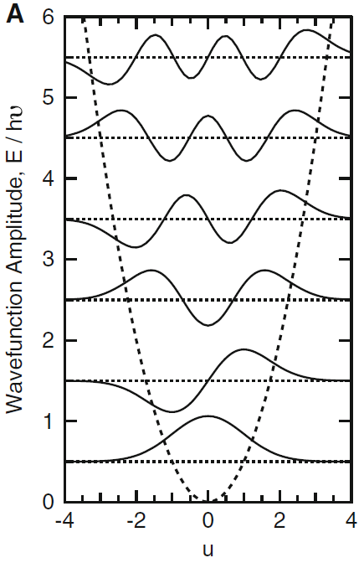
Particle in harmonic trap
Harmonic potential:
Hermite polynomial
Notes:
He’rmait

Slide 31

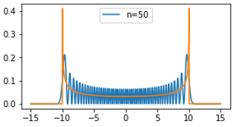
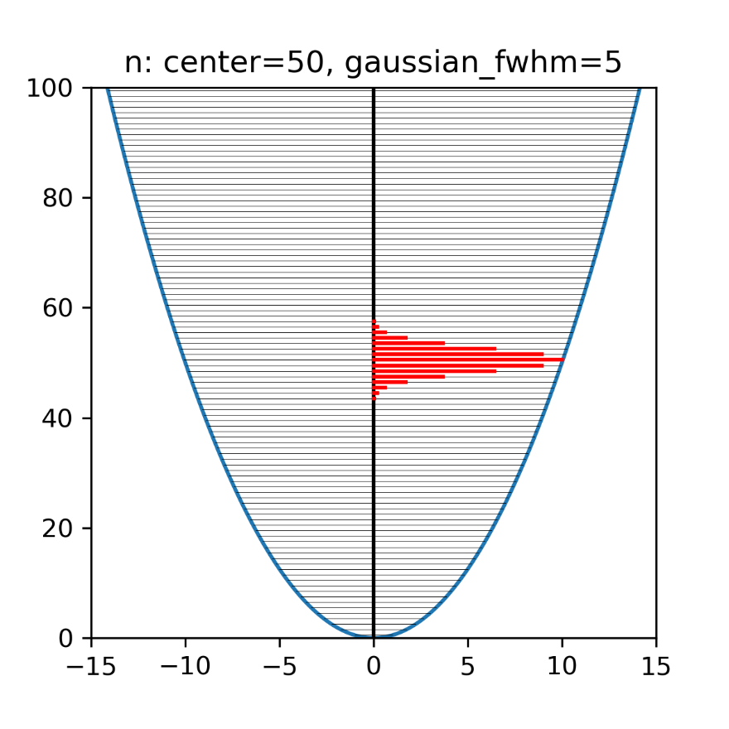
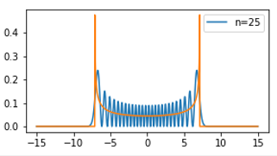
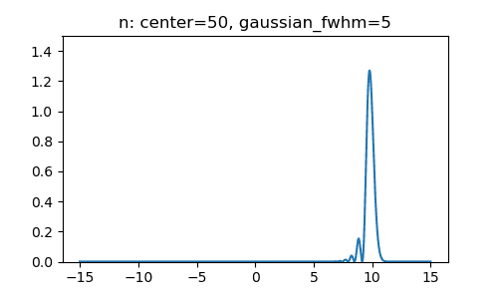
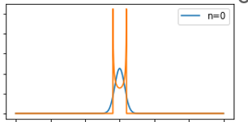
Particle in harmonic trap
Wavepacket
n=50,
fwhm = 5
Stationary states
Stationary states
Several nearby states are mixed in
Not a stationary state!
Simulation by S. Savikhin
Notes:
He’rmait

Slide 32
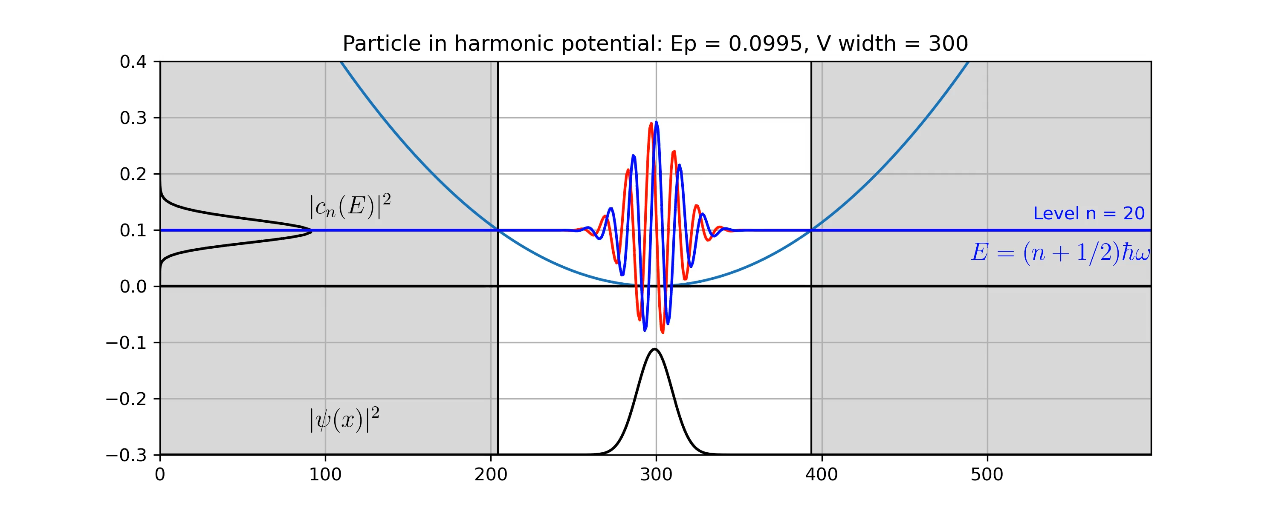
Particle in harmonic trap
Notes:
He’rmait

Slide 33


Atomic orbitals
Atomic orbitals: solution for 3D Schrödinger equation for Hydrogen-like atom with 1 electron
(in spherical coordinates)
Z – nuclear charge
Quantum numbers:
Principal quantum number: (defines energy)
Azimuthal quantum number (angular momentum)
Magnetic quantum number
Notes:
Ä’zimuthal

Slide 34
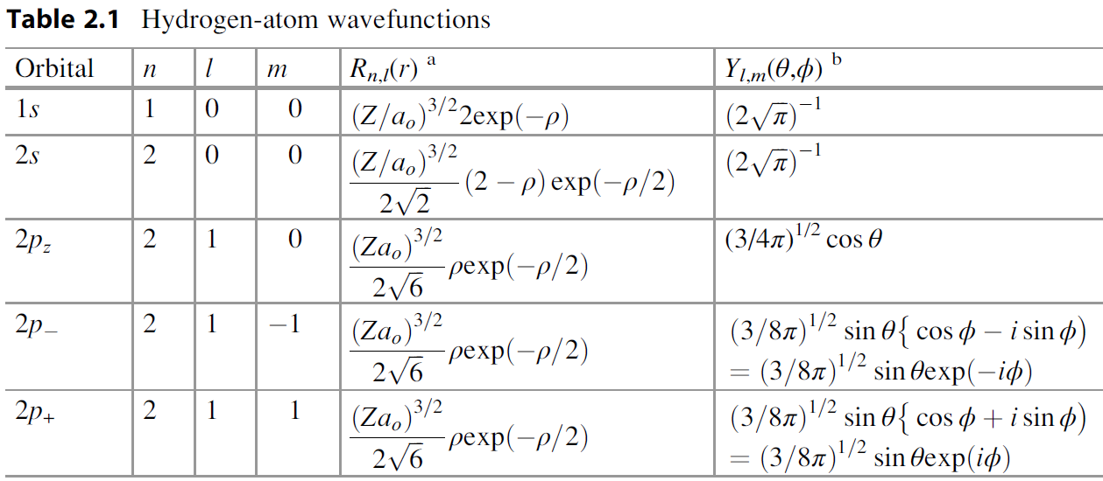
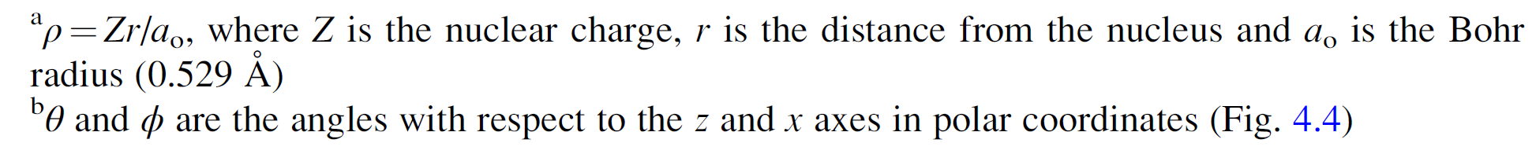
Atomic orbitals
Atomic orbitals for hydrogen-like atom of charge Z
Notes:
Ro is distance here

Slide 35
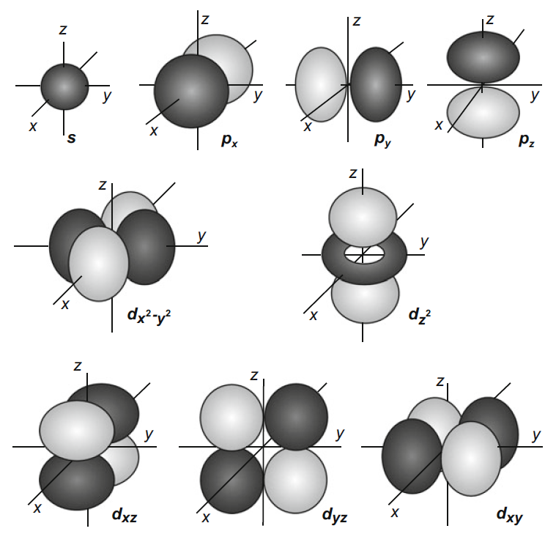
Atomic orbitals
Notes:
Stop lec01 2021spring

Slide 36
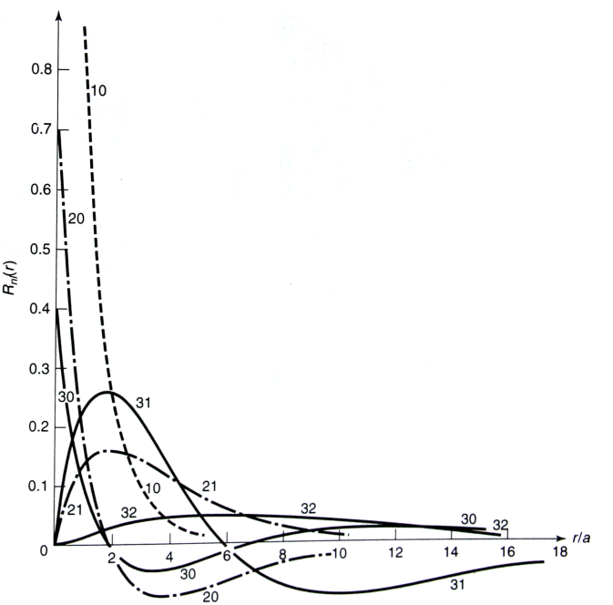
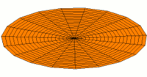
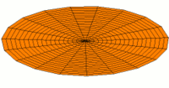
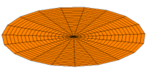
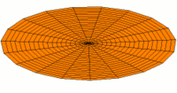
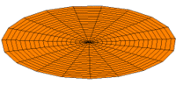

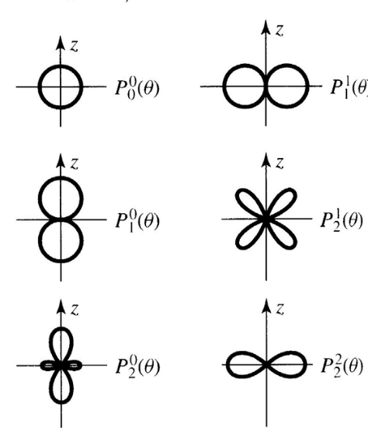
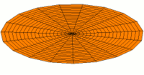
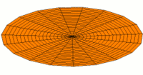
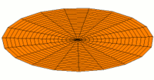
Atomic orbitals
standing waves on a circular drum
1s
2s
3s
2p
3p
4p
3d
4d
5d
http://en.wikipedia.org/wiki/Atomic_orbital
Notes:
Ask what is wrong with this animation → frequency must be different…

